Slide 1
Ruby on Rails
a high-productivity
web application framework
http://blog.curthibbs.us/
Curt Hibbs <curt@hibbs.com>

Slide 2

Agenda
What is Ruby?
What is Rails?
Live Demonstration (sort of…)
Metrics for Production
Rails Applications
Resources for more information
Notes:
Everything in this presentation is a rip-off from somewhere else.
Not only that , but this presentation is based entirely on testimonials.
If you were hoping for some facts, you’ve come to the wrong presentation.
Well…, seriously, I will be mixing facts, with developer quotes, building a live application, and showing real development metrics.
The point is to show you how productive you *could* be, if only you were using Ruby on Rails to construct web applications!

Slide 3
What is Ruby?
Short Answer:
  Ruby is the successful combination of:
    Smalltalk's conceptual elegance,
    Python's ease of use and learning, and
    Perl's pragmatism.
Long Answer:
  Well… see the following slides.
Notes:
First off, this is not really a presentation about the Ruby programming language, but since everything you see is going to be written in Ruby, I will say as little as possible, and then move on to Rails.
So then, what *is* Ruby?
I asked a number of seasoned Ruby developer’s to answer that question, and here’s some of the answers I got…
(read them)

Slide 4
What is Ruby?
  Ruby is…
  Interpreted
    Like Perl, Python
  Object-Oriented
    Like Smalltalk, Eiffel, Ada, Java
  Rapidly Gaining Mindshare in US and Europe
    Originated in Japan, very popular there

Slide 5
Why Ruby?
Easy to learn
Open source (very liberal license)
Rich libraries
Very easy to extend
Truly Object-Oriented
  Everything is an object (no primitives)
  Single inheritance (mixins give you the power of multiple inheritance with the problems).
Helpful community

Slide 6
Why Ruby?
Dynamic Features
  Duck Typing
  (uses method signatures, not class inheritance)
  Method calls are actually messages sent to an object instance
  Open classes
  Reflection
Bottom Line: write more understandable code in fewer lines
  Less code means fewer bugs

Slide 7
Why Not?
Performance
  although it rivals Perl and Python
Threading model
  Does not use native threads
Notes:
I wouldn’t use Ruby to write compute-intensive video encoders.
Threading: in certain situations, native threads can be important (not very often, though).

Slide 8
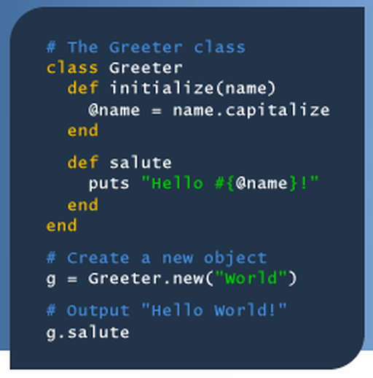
Sample Ruby Code
Code courtesy of John W. Long
Notes:
I wouldn’t use Ruby to write compute-intensive video encoders.
Threading: in certain situations, native threads can be important (not very often, though).

Slide 9
What is Rails?
Short Answer:
  An extremely productive web-application framework that is written in Ruby by
  David Heinemeier Hansson.
Long Answer:
  Well… see the following slides.

Slide 10
What is Rails?
Full Stack Framework
  Includes everything needed to create a database-driven web application using the Model-View-Controller pattern.
  Being a full-stack framework means that all layers are built to work seamlessly together.
  That way you Don’t Repeat Yourself (DRY).
Notes:
Being a full-stack framework means that all layers are built to work seamlessly together.
That way you Don’t Repeat Yourself (DRY) and you can use a single language from top to bottom.
Everything from templates to control flow to business logic is written in Ruby.

Slide 11
What is Rails?
Less Code
  Requires fewer total lines of code than other frameworks spend setting up their XML configuration files.
Convention over Configuration
  Rails shuns configuration files in favor of conventions, reflection and dynamic run-time extensions.
Configure your application by making it
  Your code and database schema are the configuration!
  No compilation phase
    Make a change, see it work.
Notes:
In striving for DRY compliance, Rails shuns configuration files and annotations in favor of reflection and run-time extensions.
For example, database schema is examined and objects are automagically constructed to represent the data as it is defined in the database.

Slide 12
What is Rails?
Rails and MVC
Model (ActiveRecord)
  Maintains the relationship between Object and Database
  Handles validation, association, transations, and more…
  Does not completely insulate the developer from SQL

Slide 13
What is Rails?
Rails and MVC
View (ActionView)
  Script-based templating system (like JSP, ASP, PHP, etc.)
  Tight controller integration
  Reusable components
  Integrated, easy to use Ajax support.

Slide 14
What is Rails?
Rails and MVC
Controller (ActionController)
  Reflection ties actions to methods
  Tight view integration
  Filters, layouts, caching, sessions, etc.

Slide 15

Rails Demonstration
Play cookbook-video.exe, a video showing development of cookbook web application from ONLamp.com article Rolling with Ruby on Rails:
http://www.onlamp.com/pub/a/onlamp/2005/01/20/rails.html
Notes:
- md forum
- rails forum
- cd forum
- ruby public\dispatch.servlet
- browse to http://127.0.0.1:3000/
- kill server
- edit config\database.yml (change database to "forum")
- create database "forum"
- ruby public\dispatch.servlet -a
Open new command window
- ruby script\new_controller (shows help)
- ruby script\new_controller Message
- browse to http://127.0.0.1:3000/message/
(error, no action defined)
- edit app\controllers\message_controller.rb
- add:
def index
render_text "Hello World!"
end
- refresh browser
- add:
def dilbert
render_text "adding new actions is easy!"
end
- browse to http://127.0.0.1:3000/message/dilbert
- ruby script\new_model (shows help)
- ruby script\new_model Message
- edit app\models\message.rb (to show what got created)
In Database:
- add table "messages" (change key "Id" to "id")
- field "title" varchar(255)
In message_controller.rb:
- Replace entire body of class with:
scaffold :message
- browse to: http://127.0.0.1:3000/message/list
- click on new message link.
- in database, add field "content" text
- refresh browser
- enter title: Wow, wasn't that easy?
- enter content: Sure was!
- press create button
- press edit button
- in database, add field "written_on" date
- refresh browser
- in database, move "written_on" to be after "title",
and change to datetime.
- refresh browser
- change the time field
- click on update
- click on back
- create app\views\message\list.rhtml containing
<h1> Getting all titles from the messages </h1>
<% for message in @messages %>
Title: <%= post.title %><br/>
<% end %>
- refresh the browser
- add to list.rhtml (just before "<% end %>"):
<%= link_to "Edit message", :action => "edit", :id => message.id %>
- refresh browser
- click Edit message
- append to title text "(almost too easy)"
- click update
- click Back
- in list.rhtml, copy "link_to" line
- paste at the end and change to:
<%= link_to "New message", :action => "new" %>
- click New message
- enter title: "This is just another message"
- enter content: "Really, it is..."
- click create
- in list.rhtml
- move <br/> tag to after the edit message link.
refresh browser

Slide 16
Database Support
Supported Databases
  MySQL
  PostgreSQL
  SQLite
  SQL Server
Coming Soon
  Oracle
  DB2
  Firebird
  more…

Slide 17
Model Objects
ActiveRecord
  Uses reflection extensively
  Automated mapping between
    classes and tables
    Attributes and columns
  Dynamically generates accessors, finders, and validators.
  Best with new DB schemas

Slide 18
Controllers
ActionController
  Rails URLs are typically of the form “/controller/action”
  A controller is implemented by a class.
  Actions map to methods in the controller
  Implicit action-to-view mapping

Slide 19
Views
ActionView
  Named (by default) after the action that renders them.
  Embeds Ruby code in the template
  (similar to JSP, ASP, PHP, etc.)
  Have access to (some) of the controller’s state

Slide 20
Server Configurations
  WEBrick
    Built-in to Rails
    Good development environment
  Apache/CGI
    Easy to set up, but slow
  Apache/mod_ruby
    Ruby interpreter per Apache process
  Apache/mod_fastcgi
    Pool of Ruby processes
  Lighttpd
    Built-in fastcgi support
    Small footprint, high performance

Slide 21
But Does it Scale?
Commercial Rails Applications
  Basecamp
    http://www.basecamphq.com
  43 Things
    http://43things.com
  Ta-Da Lists
    http://tadalists.com
  Snowdevil
    http://www.snowdevil.ca
  Bellybutton
    http://www.bellybutton.de
  Backpack
    http://www.backpackit.com/

Slide 22
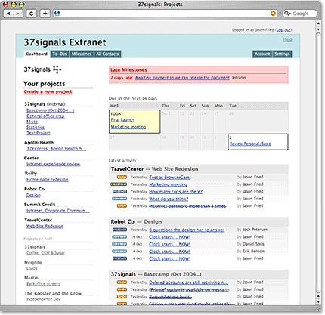
Development Metrics
Basecamp
  Launched in early 2004
    “Tens of thousands of users across 50 countries”
    2 man-months of programming by a single developer
    (the Rails author).
    4,000 Lines of Code.
  Server details
    One dual 2.2GHz Xeon,
    2G RAM.

Slide 23
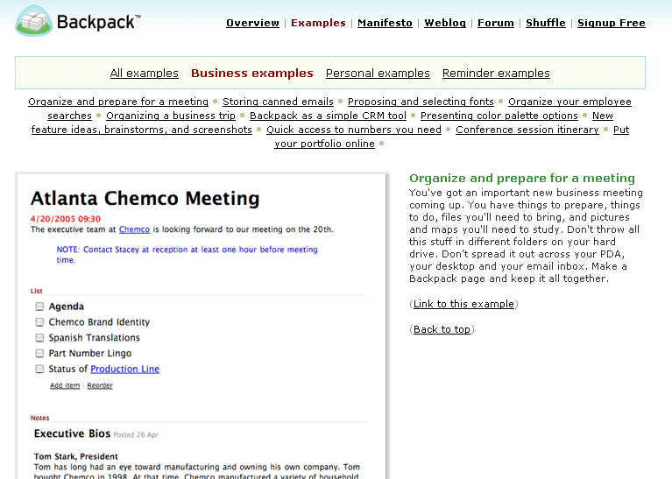
Development Metrics
Backpack
  Launched in May 2005
    http://www.backpackit.com
    Makes very heavy use of Rails’ built-in Ajax support
    for an extremely responsive user interface.

Slide 24
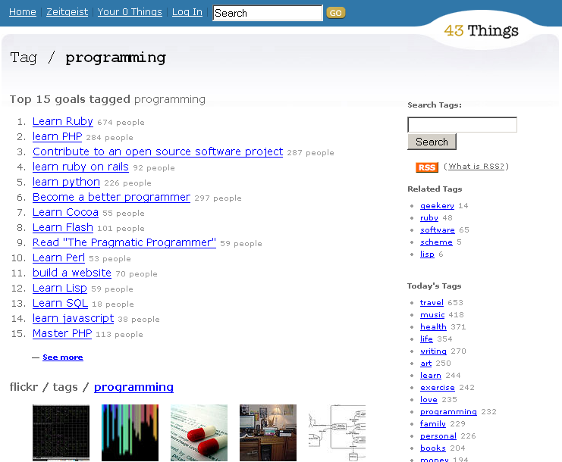
Development Metrics
43 Things
“With Ruby and Rails we went from nothing to a live site in about 3 months. Only one person in the company had any prior Ruby experience (me) and he spent half his time playing sysadmin.
“In the 2.5 months since launch we’ve done major rewrites of two of our core codepaths, added 3 large features and have done exploratory programming in two other directions
with only 5 developers.
“Our codebase is hanging in at just
under 7,000 lines of production
Ruby…”
As of February, 2005:
  9,000 registered users
  200,000 hits per day

Slide 25

Development Metrics
BellyButton.de
  Launched in February 2005
    An ecommerce site marketing pregnancy related products.
    2 developers and one graphic designer.
    2,400 Lines of Code.
    5 man-months of
    development time.

Slide 26
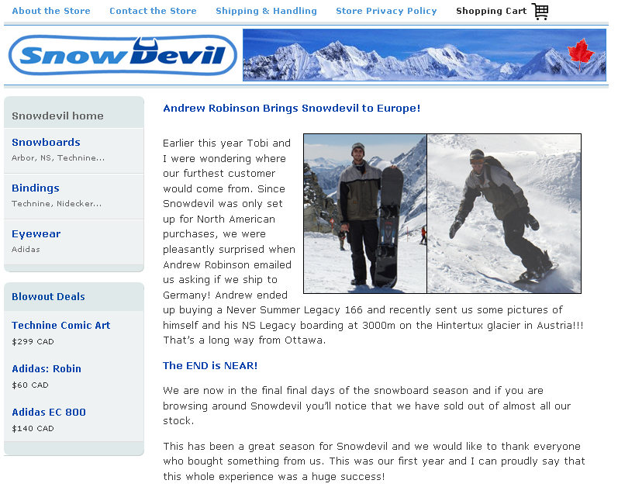
Development Metrics
SnowDevil.ca
  Launched in February 2005
    An ecommerce site marketing snowboards and related gear.
    2 developers.
    6,000 lines
    of code.
    4 months of
    development
    time.

Slide 27
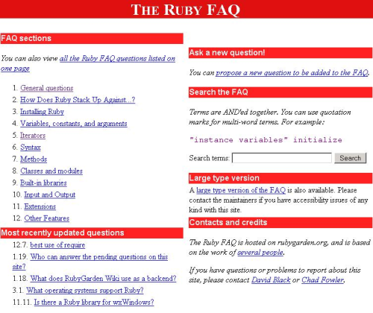
Development Metrics
RubyFAQ
  User contributed and commented FAQs
  (a production web-app) by David Black
  http://www.rubygarden.org/faq/main/index
  573 Lines of code
  5 hours of
  development
  time.

Slide 28
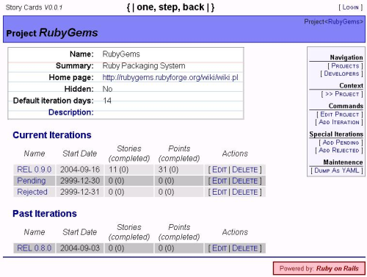
Development Metrics
StoryCards
  Web app to support XP-style development by Jim Weirich
  http://onestepback.org:3030/
  1,250 Lines of code
  8 hours of
  development
  time

Slide 29
Rails Testimonials
  “I'm absolutely floored by how fast I'm developing with Rails. Stuff that would have taken me over a week in Java + Web Work2 + Velocity + Hibernate has taken me a little over a day with Rails. I'm not even going to try to compare it to my current client's project which requires Struts.”
  - Anoop Ranganath

Slide 30
Rails Testimonials
  “Rails is the most well thought-out web development framework I've ever used. And that's in a decade of doing web applications for a living. I've built my own frameworks, helped develop the Servlet API, and have created more than a few web servers from scratch. Nobody has done it like this before. That's not to say they got it all right. It's by no means "perfect". I've got more than a few nits and picks about how things are put together. But "perfect" isn't the point. The point is that it gets you up and going fast and has plenty of depth to keep you going. And Rails does that very well.”
  - James Duncan Davidson
  was the creator of Apache Tomcat and Apache Ant and was instrumental in their donation to the Apache Software Foundation by Sun Microsystems . While working at Sun, he authored two versions of the Java Servlet API specification as well as the Java API for XML Processing.

Slide 31
Resources for more information
Ruby
  Main Ruby Site
    http://www.ruby-lang.org/en/
  One-Click Ruby Installer for Windows
    http://rubyinstaller.rubyforge.org/
  RubyForge – open source project repository
    http://rubyforge.org/
Rails
  Main Rails Site
    http://www.rubyonrails.org/
  Rails Tutorial (2 part series)
    http://www.onlamp.com/pub/a/onlamp/2005/01/20/rails.html
    http://www.onlamp.com/pub/a/onlamp/2005/03/03/rails.html
  Agile Web Development with Rails (first Rails book)
    http://www.pragmaticprogrammer.com/titles/rails/
  Ajax on Rails
    http://www.onlamp.com/
Notes:
www.onlamp.com/pub/a/onlamp/2005/01/20/rails.html

